Slide 1


Dynamic Update for
Weighted Near Maximum Independent Set

Slide 2
01
Related Work
02
CONTENT
Framework
03
Details
04
Summary

Slide 3

Related Work

Slide 4
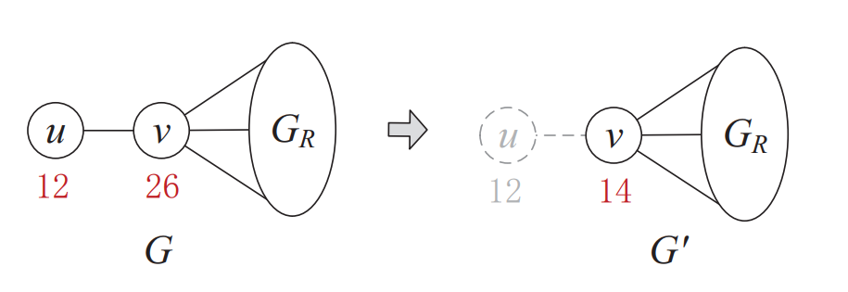
Related Work: Reduction on Weighted Graph
Weighted Degree one reduction

Slide 5
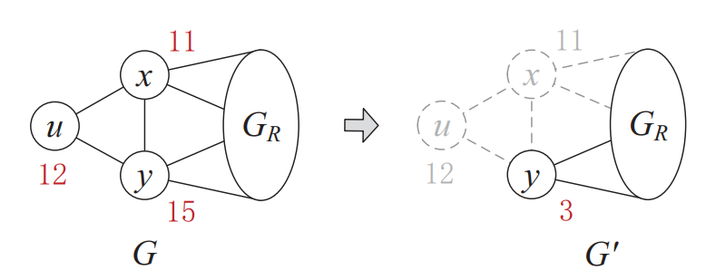
Related Work: Reduction on Weighted Graph
Weighted Triangle reduction

Slide 6
Related Work: Reduction on Weighted Graph
m
m
p
p
10
10
6
n
6
n
u
7
v
u
7
v
12
14
12
14
q
q
4
4
Weighted Domain reduction

Slide 7
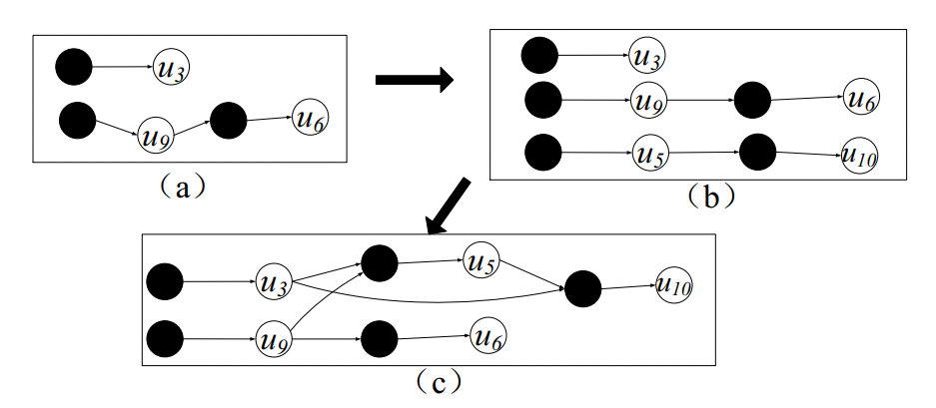
Related Work: DG-One

Slide 8
Framework

Slide 9
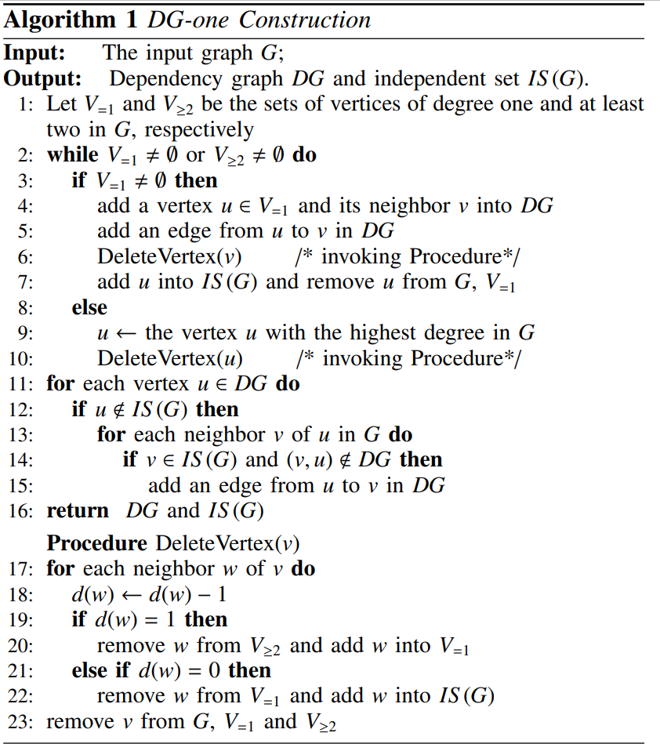
Main Idea: Weighted Dependency Graph
Degree One Reduction
Weighted Degree One Reduction
WDG and WIS(G)
Notes:
不能达到最优，但是可以保证一个相对较优的处理，并且足够work

Slide 10
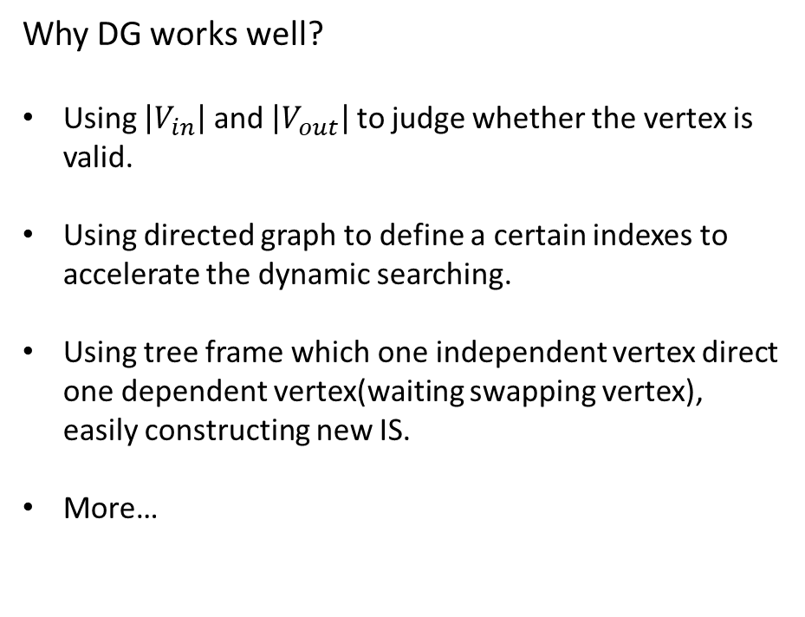
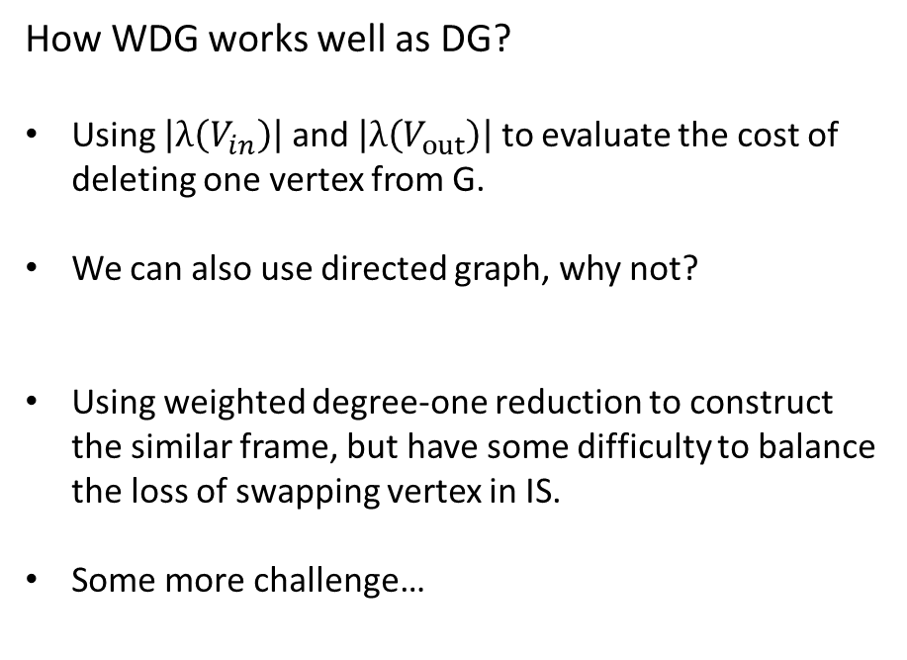
Framework: Feasibility of WDG
Why DG works well?
Using $\left|V_{in}\right|$ and $\left|V_{out}\right|$ to judge whether the vertex is valid.
Using directed graph to define a certain indexes to accelerate the dynamic searching.
Using tree frame which one independent vertex direct one dependent vertex(waiting swapping vertex), easily constructing new IS.
More…
How WDG works well as DG?
Using $\left|λ\left(V_{in}\right)\right|$ and $\left|λ\left(V_{out}\right)\right|$ to evaluate the cost of deleting one vertex from G.
We can also use directed graph, why not?
Using weighted degree-one reduction to construct the similar frame, but have some difficulty to balance the loss of swapping vertex in IS.
Some more challenge…

Slide 11
Details

Slide 12
Details: Construction WDG
Case1: w(u)>w(v)
G
G
u
v
u
v
12
6
12
6
WDG:
u
v
12
6

Slide 13
Details: Construction WDG
Case2: w(u)<w(v)
G
G
u
v
u
v
6
11
6
5
WDG:
u
v
6
6

Slide 14
Details: Challenge in Case2
w
WDG:
1
u
v
u
v
x
1
1
1
6
1
w
v
y
1
1
y
v
1
1
1
v
x
3
1

Slide 15
Details: Challenge in Case2
w
Details:
Weight of v itself change by ±w:
weight(new v) ±= w
Weight of u/w/y change by ±w:
weight(new v) ±= w
Change edges on v, add/remove a node weighted w:
Weight(new v) ±= w
Cases above may create negative new v, but it doesn’t matter!
Utilities:
Structure on v: map – all nodes v update together
Two-tuples indicates a 0-1 relation, it’s beneficial for WIS nodes output
If v is chosen, discard u/w/y
Vice versa
1
G
u
v
1
6
y
1
u
v
1
1
w
v
1
1
y
v
1
1
G
v
3

Slide 16
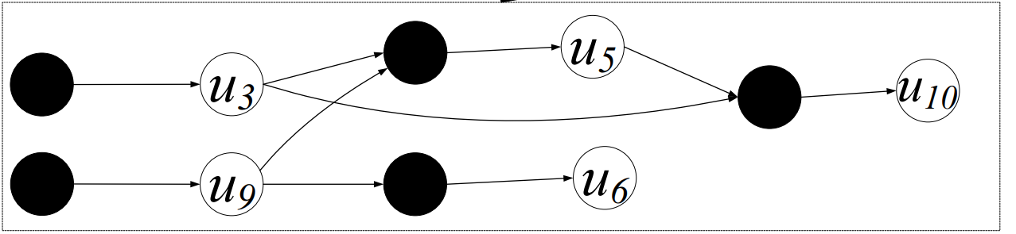
Details: Update with WDG
5
3
12
7
2
1
12
8
12
11
One fact :
The weight of independent vertex can be less or not than the weight of the dependent vertex directed by it.
So, if we swap in the WDG as we do in the DG, we may loss something and we also don’t know how many we will loss.

Slide 17
Details: Update with WDG
2
1
12
7
8
5
12
8
12
11
Update:
Remove one vertex from WIS:
swap the independent vertexes and corresponding dependent vertexes and mark the loss, and also we consider the loss if we directly remove some independent vertex. Make a balance between them.

Slide 18
Details: Update with WDG
2
1
12
7
8
7
12
8
12
11
Update:
Other update can also be transform to the first condition. And to emphasis the feature of weighted graph, we talk about how to update the weight.
Independent vertex weight up or dependent vertex weight down: never change
Independent vertex weight down or dependent vertex weight up:
Try to remove the independent vertex from the WIS, and compare the loss and the change number

Slide 19
Summary

Slide 20
Summary
2
1
15
14
8
1
12
8
12
11
DG perform very well on the unweighted graph to solve near MIS, but it depend on the unweight property so much. And for the weighted graph, the drawback is that the swapping directly may not be the best, in other words, we can’t guarantee loss of swapping to the behind must be less than loss of drop the vertex. For some strange graph, the update could seem so stutid.
So, WDG should work in the weighted graph that variance of weight is not so huge. Also, even it has many drawbacks, we believe it can behave better than computing the WIS for many times.

Slide 21
References
[1] Zheng, W., Piao, C., Cheng, H., & Yu, J. X. (2019). Computing a Near-Maximum Independent Set in Dynamic Graphs. 2019 IEEE 35th International Conference on Data Engineering (ICDE). doi:10.1109/icde.2019.00016
[2] Jiewei, Gu., Weiguo, Zheng., Yuzheng, Cai., Peng, Peng. Towards Computing a Near-Maximum Weighted Independent Set on Massive Graphs. KDD '21: Proceedings of the 27th ACM SIGKDD Conference on Knowledge Discovery & Data MiningAugust 2021. Pages 467–477. https://doi.org/10.1145/3447548.3467232

Slide 22
THANK YOU

